Slide 1
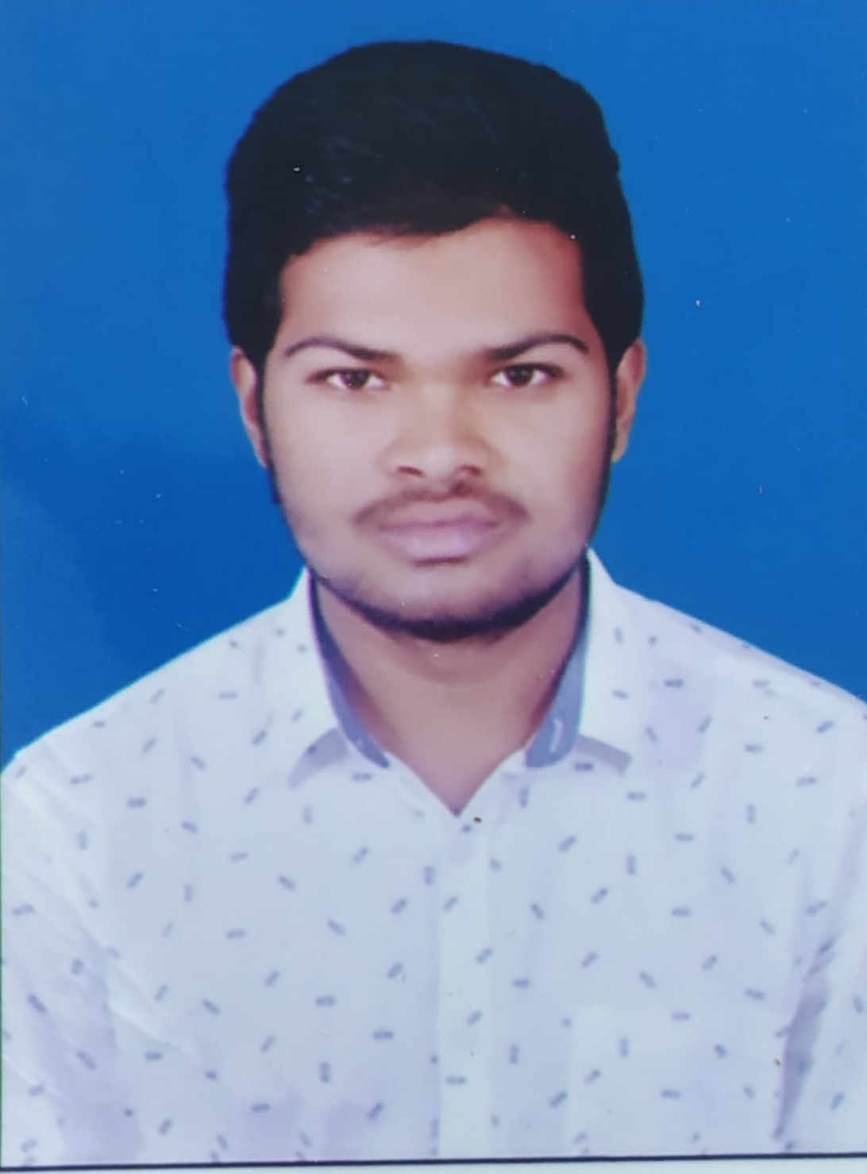



Kiran Kumar Reddy G
Bachelor of Engineering
Computer Science : 2018 - 2022
Intern At Capgemini
Skills
Java 11 /J2EE | Java Basics, OOPS, Generics, Collections, Arrays, Loops, Lambda Exp, Stream API Junit, Mockito, Servlets
Spring core | IOC & Dependency Injection, Autowire
Spring REST | REST controllers, Implementation of GET, POST, PUT & DELETE, Bean Validation & Exception Handling, Testing Services, Controller & Repository layer
Spring Data JPA | Implement DAO layer using spring Data repositories, Transaction Management
Spring Boot Microservices | Spring Boot Starters, annotations, Messaging Service, Sync/Async comms, Swagger API documents
Spring Cloud | Eureka, , Netflix Hystrix, Netflix Zuul & Config Server
Tools | Git, Postman, Maven, IDE
Angular | Components, Services, Modules, Routing, Forms & Validation, Testing using Jasmine & Karma
Database | MongoDB No Sql Basics My SQL RDS Basics
UI Tech | HTML 5 & CSS 3,JavaScript, ES6 & TypeScript Reusable templates, Optimized UI Designed
Add On skills | Communications, Team management. Leadership skills.
Hyderabad
gkiranreddy64@gmail.com
+91 8143518451
Full Stack Developer
Hands on experience in creating microservices with Springboot, Spring Security, Spring Cloud API Gateway, Eureka server.
Proficient in creating Single page Web Application in Angular with Authentication with route guards, Angular reactive forms, angular routing, CSS
Hands on experience in implementing NodeJs & spring boot
Development experience in RabbitMQ messaging service
Experience in creating documentation with Java docs and swagger and in unit testing using Junit, Mockito including code quality compliance using Sonar cube
Development experience in creating docker images and pushing to Docker Hub
In-depth understanding of deploying spring boot applications in AWS Cloud environment
On Demand Car Wash System
Completed end to end case study of On demand car wash system along with JWT authentication, Swagger and payment testing , responsive UI with HTML& CSS and Angular used for user interface.
Company Internship with “ESI(ELITE SPORTS OF INDIA)” in the “DESIGN AND DEVELOPMENT” sector.
CERTICATION IN “CONTINUOUS DELIVERY & DevOps” WITH COURSERA PLATFORM., can be verified at coursera.org/verify/EJLAVRL424PX.
. CERTICATION IN “BIGDATA” WITH COURSERA PLATFORM., can be verified at coursera.org/verify/RS5TL8S9HQ87.
Check out my work on GitHub & Video Profile

